Slide 1
AWS Identity Access Management (AWS IAM) + AWS Organizations, Directory Service, Federation & SSO
vikas

Slide 2
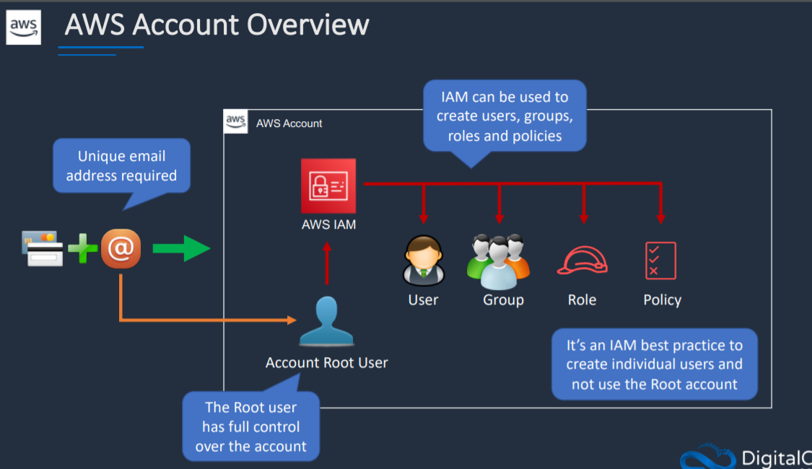
Notes:
Identity based authentication

Slide 3
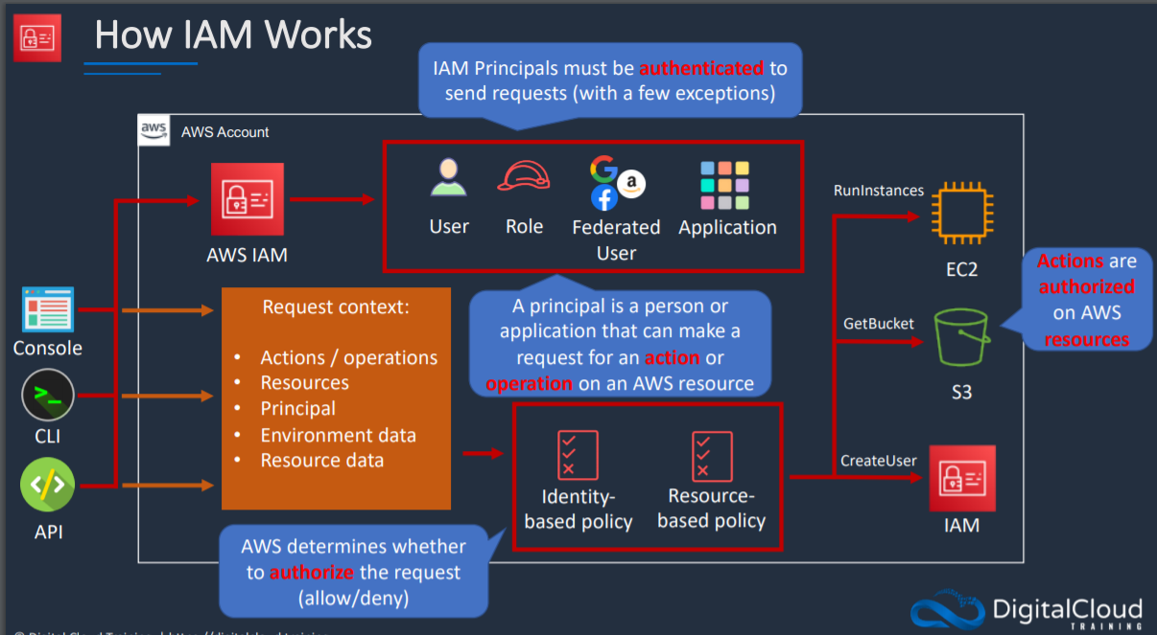

Slide 4
